Slide 1
ML ID
ANALYZER
“A machine learning-based system to detect individuals without ID cards entering a building, with analytics accessible via an Android app.”
TEAM
INTRODUCTION

Slide 2
Abhinav
Singh
Arpit
Tyagi
Aditya
Raj
Prateek
Sharma
TEAM
INTRODUCTION
DEVELOPERS Inc
210033010010
210033010016
2203330109001
2300330100183

Slide 3
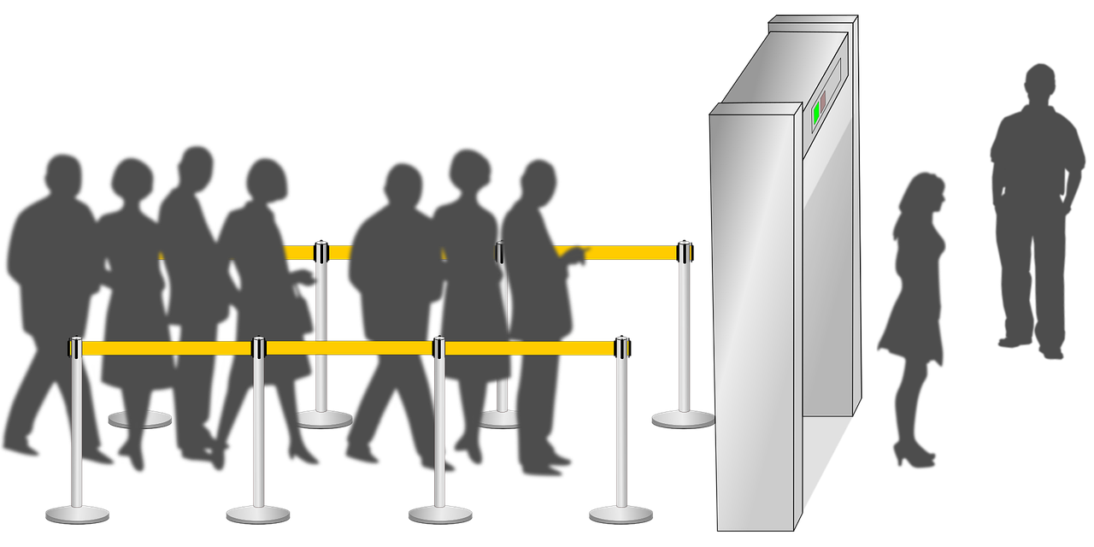
Frequent Cases of Security check Failure
Abhinav
Singh
(CSE)
Arpit
Tyagi
(CSE)
Aditya
Raj
(CSE)
Akshat
Rawat
(CSE)

Slide 4
Frequent Cases of Security check Failure

Slide 5




?
ID
ANALYZER

Slide 6
ML
ID
ANALYZER

Slide 7
PRACTICAL
Technologies used:
AI IDENTITY
ANZLYZER
PYTHON
(YOLO_v8)
MONGO DB
KOTLIN

Slide 8




Without our system

Slide 9

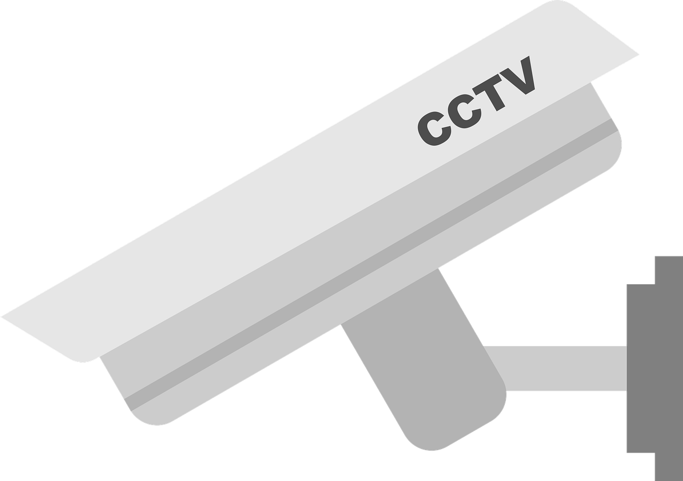
Secure Environment
With our System

Slide 10
Secure Environment

Slide 11
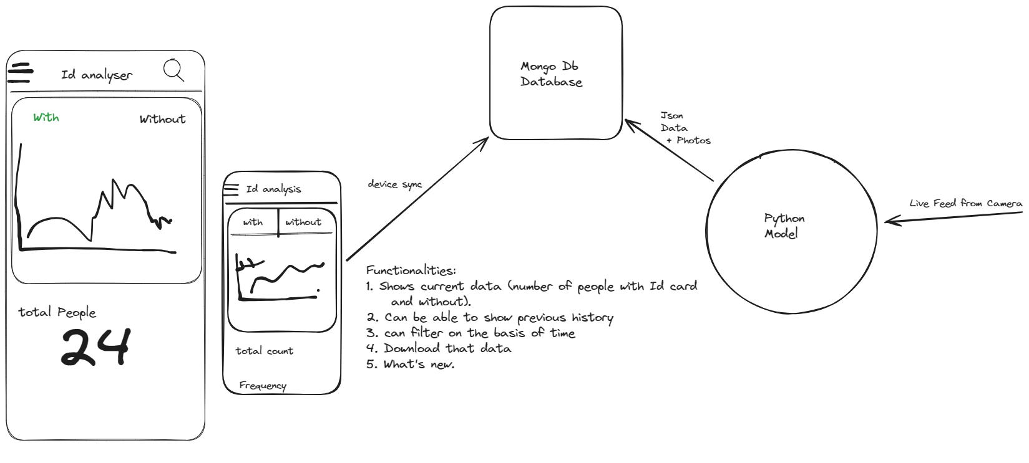
ARCHITECTURE

Slide 12
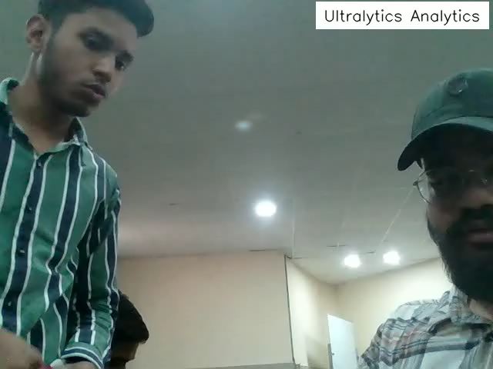
PRACTICAL
PRACTICAL

Slide 13
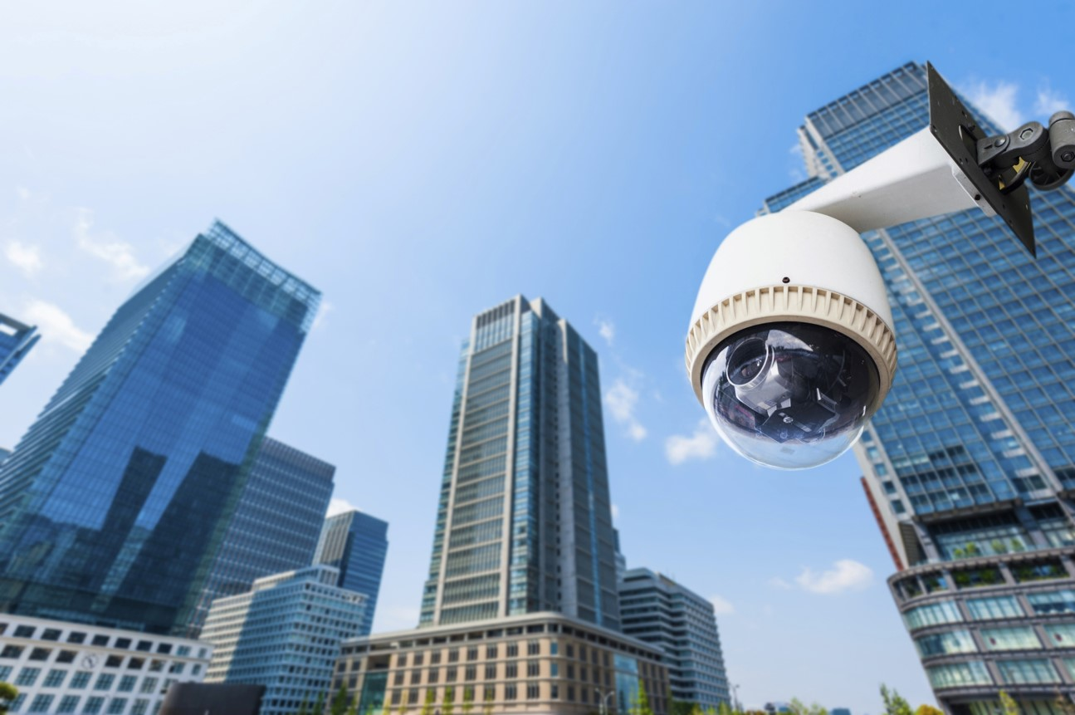
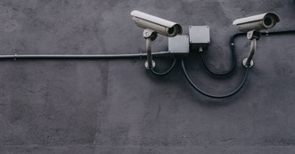
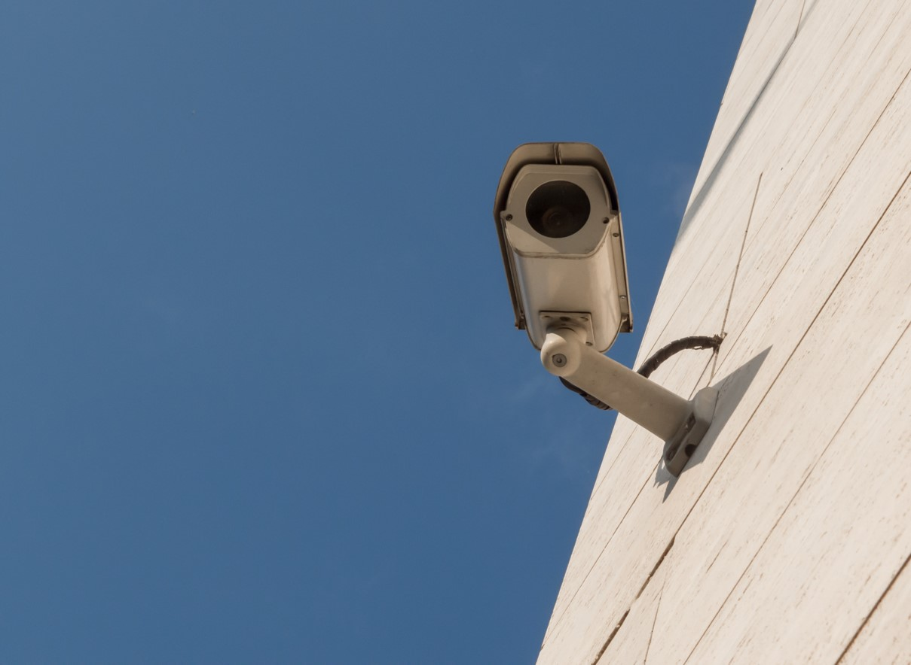


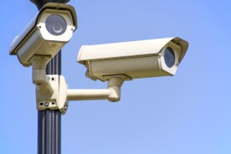
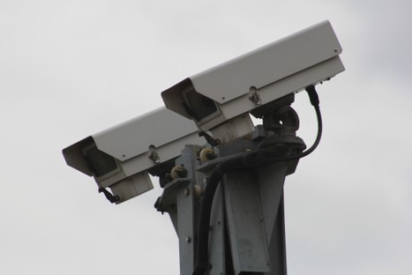
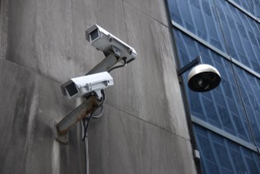
Collects data from all the connected cameras

Slide 15


Slide 16






Slide 17


Slide 18
Future Scope:
Problems Faced:
Training the model
Setting up database
Syncing devices

Slide 19
Future Scope:
Incorporating large network of CCTV cameras
Proper Facial Tracking(Possible Attendance system)
Accessing analytics
Reminders

